Slide 1
2D Transformation
Computer Graphics & Animation
Unit 2

Slide 2
What is 2D transformation?
In Computer graphics, Transformation is a process of modifying and re-positioning the existing graphics.
2D Transformations take place in a two-dimensional plane.
Transformations are helpful in changing the position, size, orientation, shape etc of the object.

Slide 3
What is 2D transformation?
In Computer graphics, Transformation is a process of modifying and re-positioning the existing graphics.
2D Transformations take place in a two-dimensional plane.
Transformations are helpful in changing the position, size, orientation, shape etc of the object.

Slide 4
2D Transformation
Translation
Rotation
Scaling
Shear
Reflection

Slide 5
Translation
2D Translation is a process of moving an object from one position to another in a two-dimensional plane.
Consider a point object O to be moved from one position to another in a 2D plane.

Slide 6
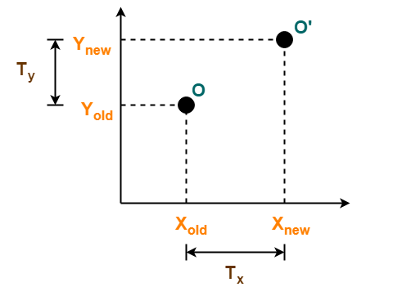
Example
Initial coordinates of the object O = (Xold, Yold)
New coordinates of the object O after translation = (Xnew, Ynew)
Translation vector or Shift vector = (Tx, Ty)
Given a Translation vector (Tx, Ty)
Tx defines the distance the Xold coordinate has to be moved.
Ty defines the distance the Yold coordinate has to be moved.

Slide 7
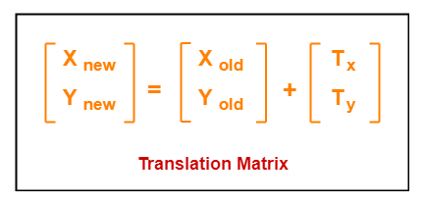
Matrix Representation

Slide 8
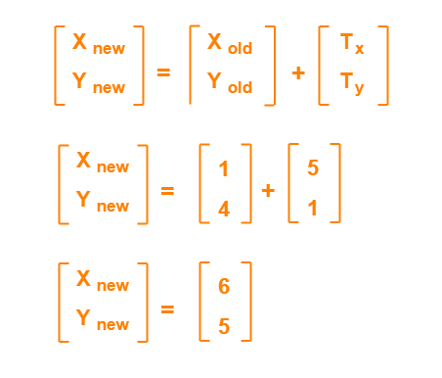
Problem-01:
Given a circle C with radius 10 and center coordinates (1, 4). Apply the translation with distance 5 towards X axis and 1 towards Y axis. Obtain the new coordinates of C without changing its radius.
Solution:

Slide 9
Sum for practice
Given a square with coordinate points A(0, 3), B(3, 3), C(3, 0), D(0, 0). Apply the translation with distance 1 towards X axis and 1 towards Y axis. Obtain the new coordinates of the square.

Slide 10
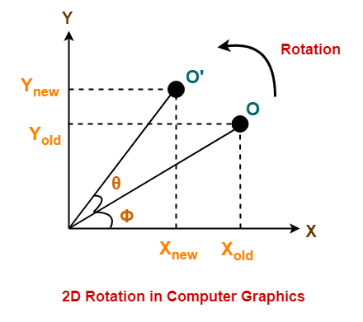
Rotation
2D Rotation is a process of rotating an object with respect to an angle in a two-dimensional plane.
Consider a point object O has to be rotated from one angle to another in a 2D plane.
Initial coordinates of the object O = (Xold, Yold)
Initial angle of the object O with respect to origin = Φ
Rotation angle = θ
New coordinates of the object O after rotation = (Xnew, Ynew)

Slide 11
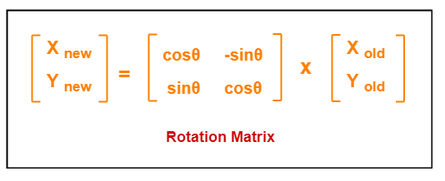
Matrix representation

Slide 12
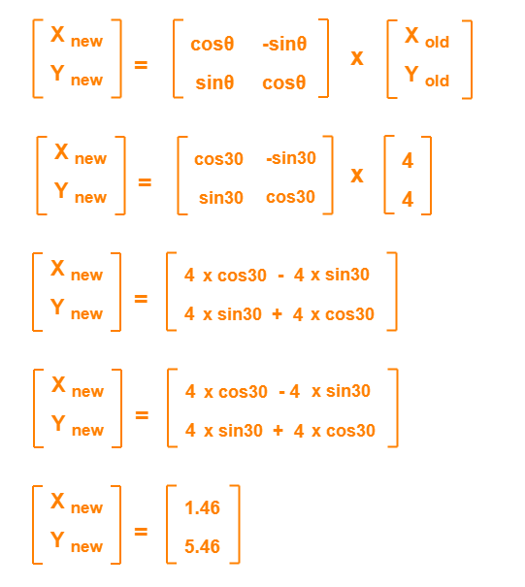
Example
Given a line segment with starting point as (0, 0) and ending point as (4, 4). Apply 30-degree rotation anticlockwise direction on the line segment and find out the new coordinates of the line.

Slide 13
Sum for practice
Given a triangle with corner coordinates (0, 0), (1, 0) and (1, 1). Rotate the triangle by 90 degree anticlockwise direction and find out the new coordinates.

Slide 14
scaling
Scaling is a process of modifying or altering the size of objects.
may be used to increase or reduce the size of object.
subjects the coordinate points of the original object to change.
Scaling factor determines whether the object size is to be increased or reduced.
If scaling factor > 1, then the object size is increased.
If scaling factor < 1, then the object size is reduced.

Slide 15
example
Let-
Initial coordinates of the object O = (Xold, Yold)
Scaling factor for X-axis = Sx
Scaling factor for Y-axis = Sy
New coordinates of the object O after scaling = (Xnew, Ynew)
This scaling is achieved by using the following scaling equations-
Xnew = Xold x Sx
Ynew = Yold x Sy

Slide 16
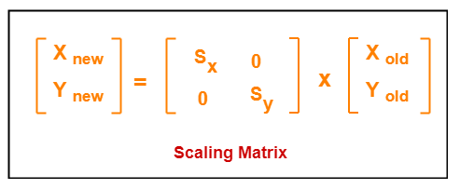
Matrix representation

Slide 17
Example
Given a square object with coordinate points A(0, 3), B(3, 3), C(3, 0), D(0, 0). Apply the scaling parameter 2 towards X axis and 3 towards Y axis and obtain the new coordinates of the object.
Given-
Old corner coordinates of the square = A (0, 3), B(3, 3), C(3, 0), D(0, 0)
Scaling factor along X axis = 2
Scaling factor along Y axis = 3

Slide 18
Sum for practice
A Square object with the coordinate points P (1, 4), Q (4, 4), R (4, 1), T (1,1). Apply the scaling factor 3 on the X-axis and 4 on the Y-axis. Find out the new coordinates of the square?

Slide 19

recap
Translation – P`=P+T
Rotation – P`=R * P
Scaling – P`=S * P

Slide 20

Other Transformations
Reflection
Shear

Slide 21
Reflection
Reflection is a kind of rotation where the angle of rotation is 180 degree.
The reflected object is always formed on the other side of mirror.
The size of reflected object is same as the size of original object.
Consider a point object O has to be reflected in a 2D plane.
Let-
Initial coordinates of the object O = (Xold, Yold)
New coordinates of the reflected object O after reflection = (Xnew, Ynew)

Slide 22
Reflection
Reflection on X-axis
Reflection on Y-axis

Slide 23
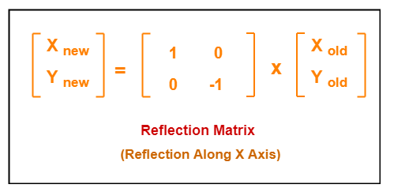
Reflection on X-axis
Xnew = Xold
Ynew = -Yold

Slide 24
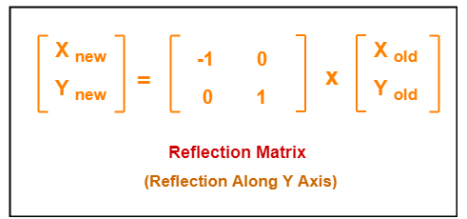
Reflection on Y-axis
Xnew = -Xold
Ynew = Yold

Slide 25
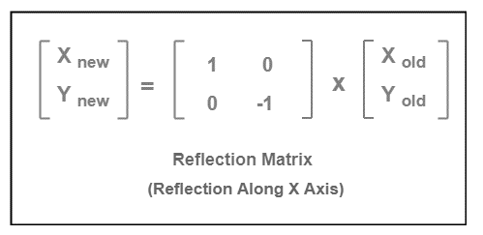
Example
Given a triangle with coordinate points A(3, 4), B(6, 4), C(5, 6). Apply the reflection on the X axis and obtain the new coordinates of the object.
Solution:
Find what is given?
Old corner coordinates of the
triangle = A (3, 4), B(6, 4), C(5, 6)
Reflection to be taken on the X axis
Find A`, B`,C` using given matrix.
Plot the given Triangle to verify the output.

Slide 26
Sum for practice
Given a triangle with coordinate points A(3, 4), B(6, 4), C(5, 6). Apply the reflection on the Y axis and obtain the new coordinates of the object.

Slide 27
shear
X-Shear
Y-Shear

Slide 28
shear
X-Shear
Y-Shear

Slide 29
Shear
It is a technique to change the shape of an existing object in a two dimensional plane.
The object size can be changed along X direction as well as Y direction.
Consider a point object O has to be sheared in a 2D plane.
Consider-
Initial coordinates of the object O = (Xold, Yold)
Shearing parameter towards X direction = Shx
Shearing parameter towards Y direction = Shy
New coordinates of the object O after shearing = (Xnew, Ynew)

Slide 30
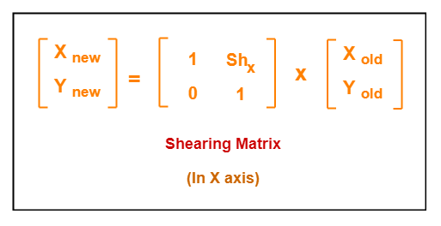
Shearing in X-axis
Shearing in X axis is achieved by using the following shearing equations-
Xnew = Xold + Shx . Yold
Ynew = Yold

Slide 31
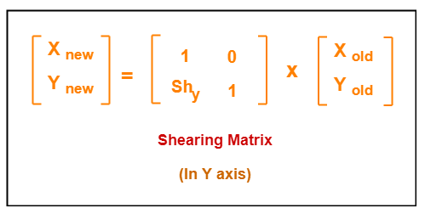
Shearing In y-axis
Shearing in Y axis is achieved by using the following shearing equations-
Xnew = Xold
Ynew = Yold + Shy . Xold

Slide 32
example
Given a triangle with points (1, 1), (0, 0) and (1, 0). Apply shear parameter 2 on X axis and 2 on Y axis and find out the new coordinates of the object.
Given-
Old corner coordinates of the triangle = A (1, 1), B(0, 0), C(1, 0)
Shearing parameter towards X direction (Shx) = 2
Shearing parameter towards Y direction (Shy) = 2
Find A`,B` & C` using the matrices.
Plot the new co-ordinates for verification.

Slide 33
summary
2D transformation is a process of modifying and re-positioning the existing graphics.
Basic types of transformation – Translation, Rotation, Scaling.
Other types of transformation – Shear & Reflection.
Translation performs addition.
Rotation multiplies 2X2 matrix with original co-ordinates (Rotation matrix R along with angle ꝋ)
Scaling multiplies 2X2 matrix with original co-ordinates (Scaling matrix S)

Slide 34
Quiz

Slide 35
Thank you!

